Slide 1




Optimized Vibration Mitigation in Design of Satellite Payload Support
Michael Kronenfeld and Samy Missoum, Ph.D.
NASA Space Grant Consortium
Statewide Symposium – Tempe, Arizona
April 22nd, 2017

Slide 2

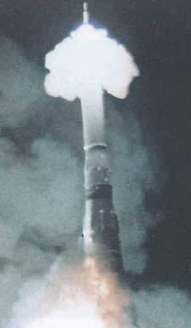
Motivation
Vibration testing developed
during World War II
  Mechanical and electrical
  system qualification
Pogo Oscillation
(longitudinal ‘sloshing’)
  Vibration in rockets from
  surge in engine pressure
  Saturn V rocket, Apollo 6
  and 13 missions affected
  Soviet Union’s N1 rocket
  test flight failure
Motivation
Objectives
Methods
Results
Conclusion
http://www.russianspaceweb.com/images/rockets/n1/5l/sas_firing_1.jpg
2

Slide 3
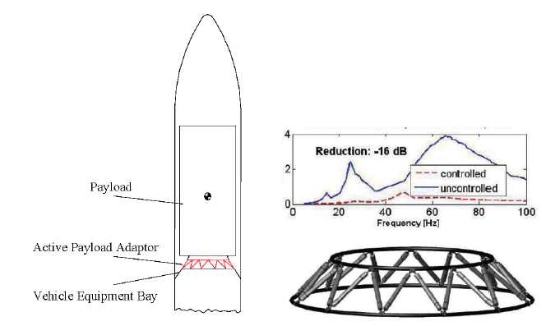
Motivation
Excess vibration can damage satellite payloads
  Sensitive electronic components
  Transportation and launch sequences
Random Vibration: Excitation within bandwidth
  Qualification test and best simulation
  of realistic environments
Motivation
Objectives
Methods
Results
Conclusion
2011 Active and Morphing Aerospace Structures [Baier, H]
3

Slide 4
Objectives
Optimized design for payload support structure
Goals
  Mitigate effects of external vibration
    Minimize response PSD to random vibration
    PSD: Power Spectral Density
  Optimization of specific geometric parameters
Motivation
Objectives
Methods
Results
Conclusion
4

Slide 5
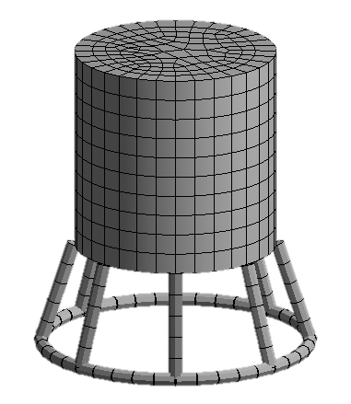
Methods
Parameterized finite element model (FEM)
  Algorithm outputs optimized model geometry
Motivation
Payload Radius
Objectives
Height
Cross-Sectional Area
Methods
Number of Struts
Offset
Results
Conclusion
Radius
Legend
Design Variables
5

Slide 6
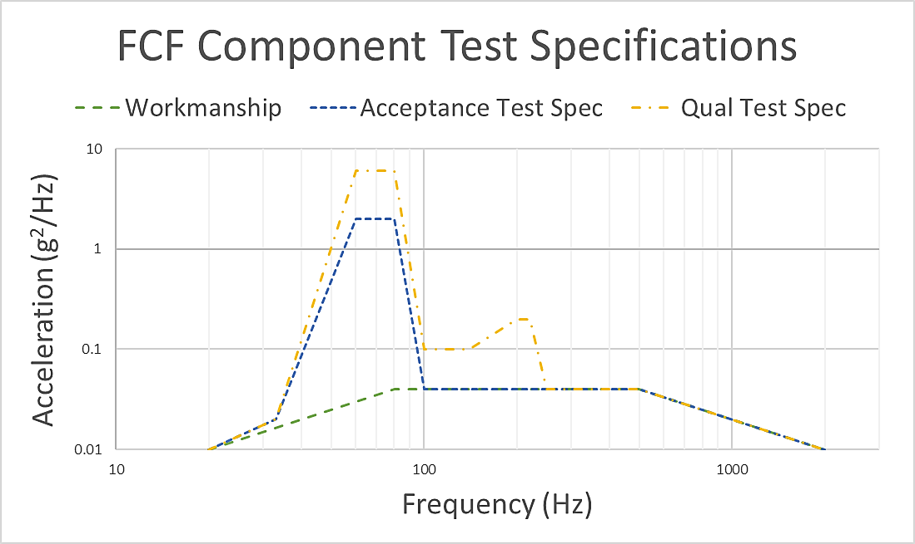
Sample Excitation
NASA and US Military Standards
  Random vibration testing for transport and launch
  Time spectrum (probability) to frequency spectrum
  Amplitudes are random with Gaussian distribution
Motivation
Objectives
Methods
Results
Conclusion
6
Notes:
Flight Critical Forward

Slide 7
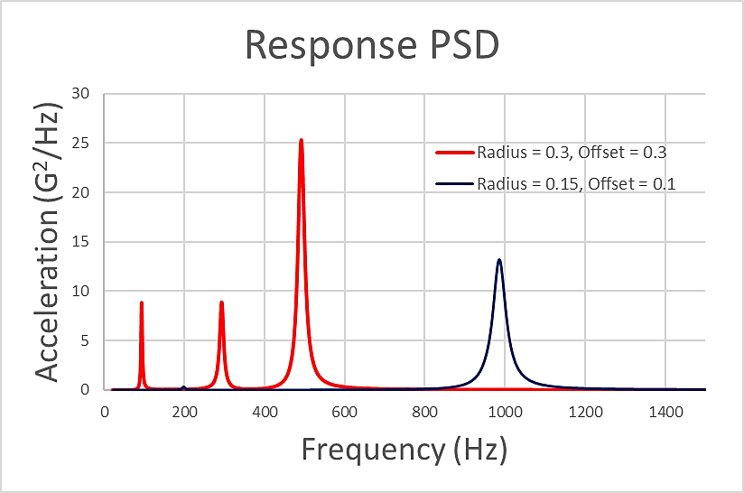
PSD Optimization
Optimization problem
  Minimize response PSD with parameterized values
  Support radius and offset distance from payload
  Cross-sectional area and number of struts
Motivation
Objectives
Methods
Results
Conclusion
7

Slide 8
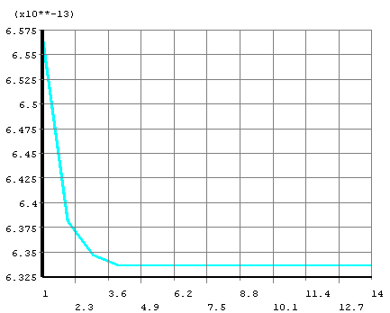
Conclusions
Design algorithm functional
  Next step is the full
  automation of optimization
  Literature inputs demonstrate
  engineering tests
Further research and development for model
  Tuned mass-damping system (TMD) for struts
  Nonlinear energy sinks (NESs)
  Fatigue damage for time exposure of 3σ vibration
Enhancement and applications
  Topology optimization of satellite support
  3D printed design and vibration / shock testing
Motivation
Objectives
Methods
Results
Conclusion
8

Slide 9
Thank You

